Slide 1
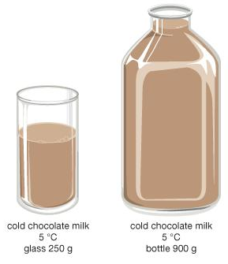
Daily Review
Comparing Thermal Energy
Identify whether the temperature or the volume of the objects is the same. Same temperature = larger object has more thermal energy Same volume = hotter object has more thermal energy Explain why the object has more thermal energy
The objects are the same ________. The __________ has more thermal energy because _________________.

Slide 2
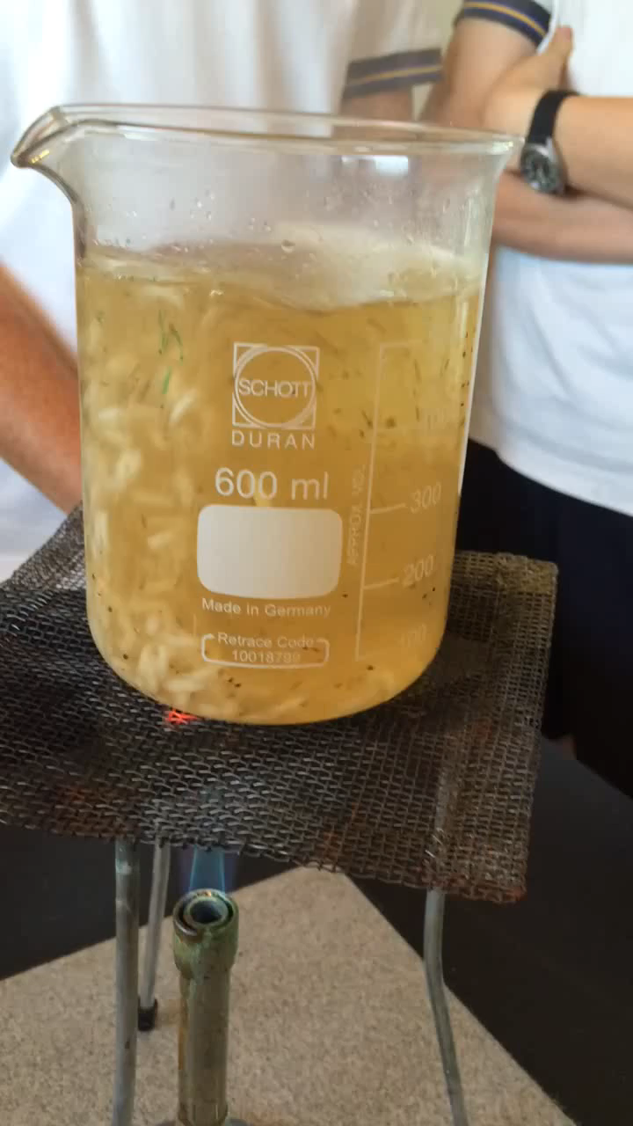
Daily Review
Conduction, Convection and Radiation
Conduction: thermal energy transfer through objects touching
Convection: thermal energy transfer through moving particles in liquids and gases
Radiation: thermal energy transfer through a substance without heating it
Briefly describe an example of each of the three methods of thermal energy transfer in the video.

Slide 3
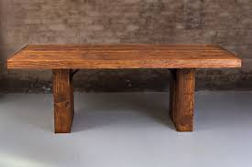
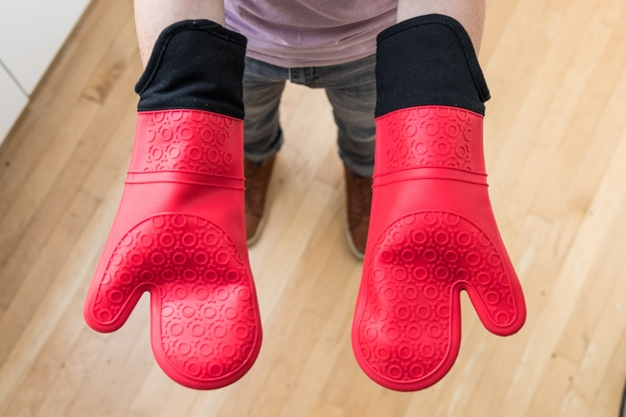
Daily Review
CFU 1
What is a thermal insulator?
Insulators
A thermal insulator is any material that prevents thermal energy from passing through it.
Most non-metallic materials, for example air, plastic, wood and rubber, are good insulators of thermal energy.
Some insulators are better at preventing energy transfer than others.
CFU 2
What type of materials make good insulators? Name two examples of good insulators.

Slide 4
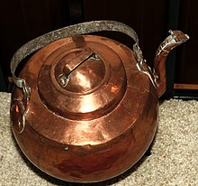
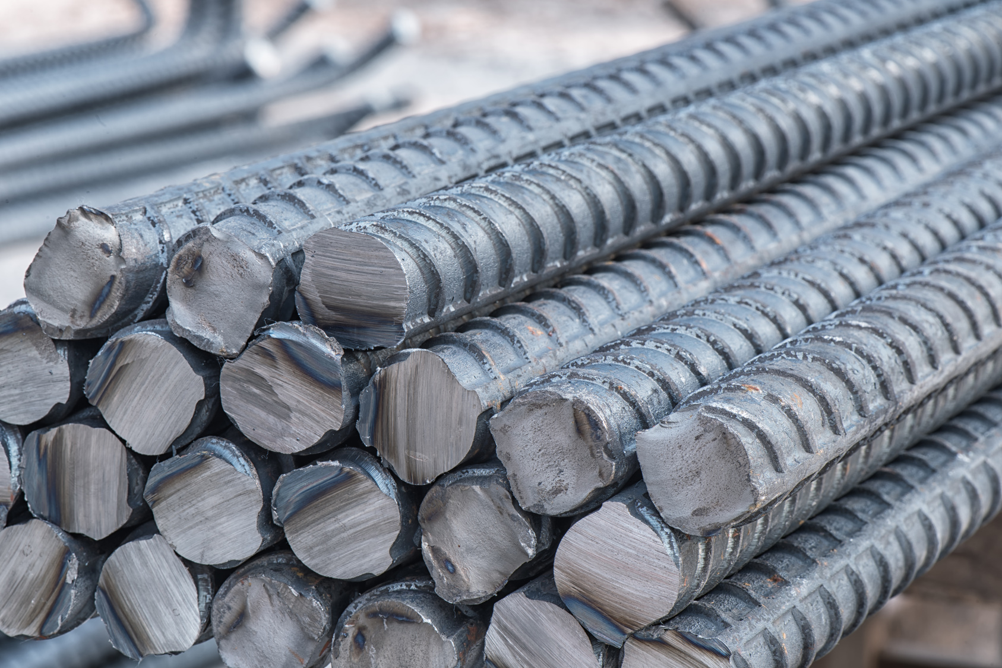
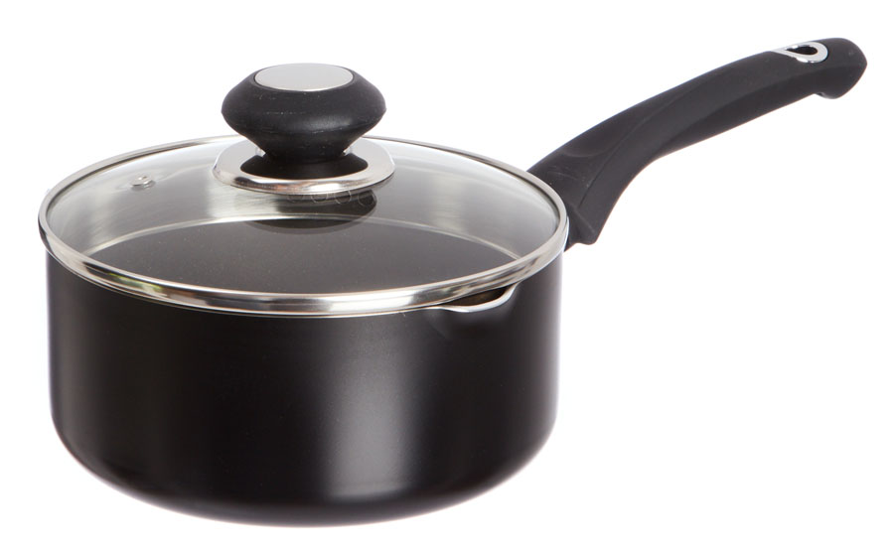
Daily Review
CFU 1
What is a thermal conductor?
Conductors
A thermal conductor is any material that allows thermal energy to flow easily through it.
Metals, for example copper and iron, are good conductors of thermal energy.
Some conductors are better than others, transferring energy more easily.
CFU 2
What type of materials make good conductors? Name two examples of good conductors.
CFU 3
Why are the base and sides of saucepans often made from metal, while the handle is made from plastic?

Slide 5
Specific Heat Capacity

Slide 6
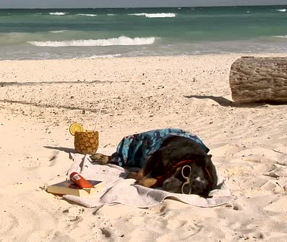
Learning Objectives
CFU
What are we going to learn?
Describe specific heat capacity.
Use a formula to calculate values related to specific heat capacity.
Activate Prior Knowledge
Think, Pair, Share: If you put a metal object and a wooden object in the Sun, which one will feel hotter when you touch it? Expain your choice.

Slide 7
Concept Development
CFU 1
What is a thermal conductor?
Thermal Conductors
Thermal conductors are materials that allow thermal energy to pass through them easily.
Some materials are better conductors than others.
Good thermal conductors absorb thermal energy readily.
A material’s ability to conduct thermal energy is measured by its specific heat capacity.
CFU 2
What makes a good thermal conductor?
CFU 3
How do we measure a material’s ability to conduct thermal energy?

Slide 8
Concept Development
CFU 1
What does specific heat measure?
Specific Heat Capacity
The specific heat capacity of a substance is the amount of energy, measured in Joules (J), that is needed to raise the temperature of 1kg of the substance by 1°C.
A substance with a high specific heat capacity heats up more slowly than one with a low specific heat capacity.
This is because it needs to absorb more thermal energy before it heats up.
Specific heat is measured in J/kg/°C.
CFU 2
What units do we use for specific heat?
CFU 3
Why does a substance with a high specific heat warm up slower than one with a low specific heat?
CFU 4
Which of the substances in the table will heat up the fastest? Explain your choice.
Substance | Specific Heat Capacity (J/kg/°C)
Sand | 880
Water | 4200
Iron | 440

Slide 9
Concept Development
CFU 1
In terms of specific heat capacity, how are thermal conductors different to thermal insulators?
Specific Heat Capacity
Good thermal conductors tend to have a low specific heat capacity, and heat up quickly.
Good thermal insulators tend to have a high specific heat capacity, and heat up slowly.

Slide 10
Concept Development
CFU 1
Write the equation that shows the relationship between energy and specific heat.
Relationship Between Energy and Specific Heat Capacity
Energy required = mass x heat capacity x temperature change
Q = m x c x ΔT
Where
Q = energy required (J)
m = mass (kg)
c = specific heat capacity (J/kg/°C)
ΔT = temperature change (°C)
CFU 2
A students uses a value which has the unit ‘kg’. Which part of the equation does this represent?
Q
CFU 3
What units are used for specific heat capacity?
m
c
ΔT

Slide 11
Skill Development/Guided Practice
Calculating Values Related to Specific Heat
Write down the information you are given and what you are trying to find. Rearrange the equation to find your unknown. Substitute values into the equation and solve. Add appropriate units
Calculate the amount of energy required to raise the temperature of 2 kg of water by 5°C, given that the specific heat capacity of water is 4200 J/kg/°C.
1. Q = ?
m = 2 kg
c = 4200 J/kg/°C
ΔT = 5°C
2. Q = m c ΔT
3. Q = 2 x 4200 x 5
Q = 42 000
4. 42 000 J of energy is required.
Q
m
c
ΔT

Slide 12
Skill Development/Guided Practice
Calculating Values Related to Specific Heat
Write down the information you are given and what you are trying to find. Rearrange the equation to find your unknown. Substitute values into the equation and solve. Add appropriate units
Calculate the amount of energy required to raise the temperature of 5 kg of copper by 2°C, given that the specific heat capacity of copper is 390 J/kg/°C.
1. Q = ?
m = 5 kg
c = 390 J/kg/°C
ΔT = 2°C
2. Q = m c ΔT
3. Q = 5 x 390 x 2
Q = 3 900
4. 3 900 J of energy is required.
Q
m
c
ΔT

Slide 13
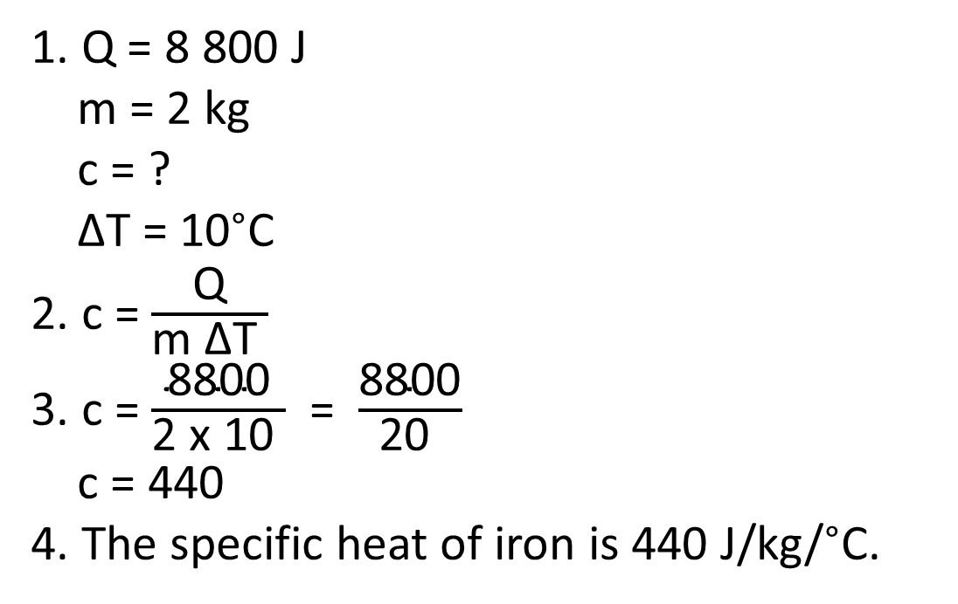
Skill Development/Guided Practice
Calculating Values Related to Specific Heat
Write down the information you are given and what you are trying to find. Rearrange the equation to find your unknown. Substitute values into the equation and solve. Add appropriate units
An 2 kg iron bar heats up from 10°C to 20°C when it is heated with 8 800 J of energy. What is the specific heat capacity of iron in J/kg/°C?
1. Q = 8 800 J
m = 2 kg
c = ?
ΔT = 10°C
2. c = $\frac{\text{Q}}{\text{m} \text{Δ}\text{T} }$
3. c = $\frac{\text{8800}}{\text{2 }\text{x}\text{ 10 }}$ = $\frac{\text{8800}}{\text{20} }$
c = 440
4. The specific heat of iron is 440 J/kg/°C.
Q
m
c
ΔT

Slide 14
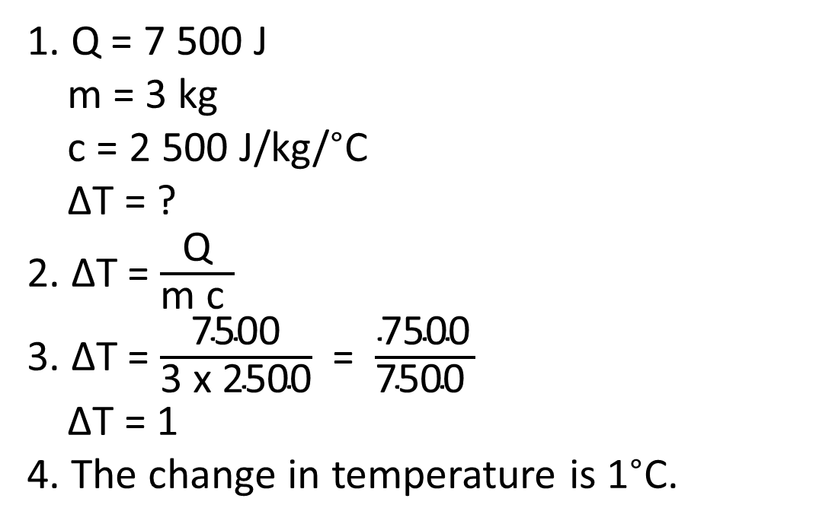
Skill Development/Guided Practice
Calculating Values Related to Specific Heat
Write down the information you are given and what you are trying to find. Rearrange the equation to find your unknown. Substitute values into the equation and solve. Add appropriate units
The specific heat capacity of methanol is 2 500 J/kg/°C. What would be the temperature change if 7 500 J of energy were transferred into 3 kg of methanol?
1. Q = 7 500 J
m = 3 kg
c = 2 500 J/kg/°C
ΔT = ?
2. ΔT = $\frac{\text{Q}}{\text{m} \text{c} }$
3. ΔT = $\frac{\text{7500}}{\text{3} \text{x}\text{ 2500}}$ = $\frac{\text{7500}}{\text{7500} }$
ΔT = 1
4. The change in temperature is 1°C.
Q
m
c
ΔT

Slide 15
Relevance
Understanding specific heat capacity will help you explain why sand heats up faster than water at the beach.
It will also help you understand why:
Water is used to cool down objects, like car radiators, because it can absorb a large amount of heat before its temperature starts to rise.
Copper and iron are used to make pots and pans for cooking. They both have low specific heat capacities, so only require a small amount of energy to cause an increase in temperature.

Slide 16
Skill Closure
Q
What does the specific heat capacity of a substance measure?
m
c
ΔT
Skill Closure
Which substance in the table will be able to absorb the most energy before its temperature raises 1°C? Explain your choice.
Substance | Specific Heat Capacity (J/kg/°C)
Sand | 880
Water | 4200
Iron | 440
Skill Closure
An iron bar with a mass of 2 kg is heated with 44 000 J of energy. What will be its change in temperature?

Slide 17
Independent Practice
Complete the “Specific Heat Capacity” worksheet on a paper copy. Don’t forget to show your working out.

